Slide 1




WEB PAGES DESIGN
Image Manipulations, Audio, and Video
Lecturer: Dr. Atheer Akram AbdulRazzaq
Lecture 9.
Class 2.
Time: 10:30 - 12:30
Department: Businesses Information Technology (BIT)

Slide 2
Outline
Outline
Positioning Images
Shortcut Icon
iframe Element
CSS Image Sprites
Audio
Background Images
Web Fonts
Video
Centering Content Within the Viewport, Color Gradients
Summary

Slide 3
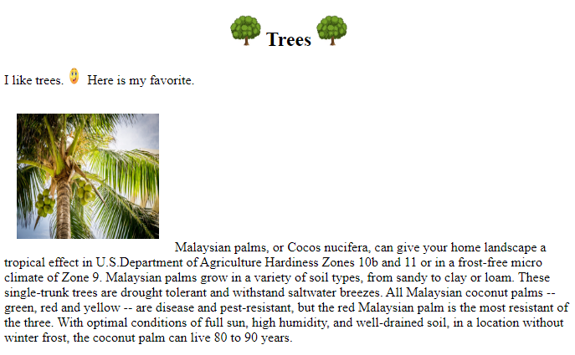
Outline
Positioning Images
The img element is an inline element (more formally, a phrasing element), so it gets displayed within the normal flow of its surrounding text. That works well for small images (icons), but not so well for medium and large images.
In Figure1. we can See the smiley face image, It’s a small image, an icon, and its default inline positioning works well. But the tree photograph? They’re taller and their default inline positioning causes the browser to generate quite a bit of dead space above the text lines in which they’re embedded. In general, you should avoid such dead space.
Figure1. Trees web page with default picture positioning

Slide 4
Outline
Positioning Images (continue…)
To avoid wasted space around a medium or large image, you might want to display it on a line by itself by surrounding it with a block element.
Let’s focus on another technique—“floating” an image to the left or to the right, so its adjacent text displays along its right or left border.
In example 1., note how the tree photograph are floated to the left or to the right with the text wrapping around the photograph borders. To float an image, you apply a CSS rule to the img element, where the CSS rule uses the float property and a value of left or right. here are the CSS rules in charge of floating the tree photograph:
.left {float: left; margin: 8px;} <!-- used with left side -->
The margin property in this example is not required for floating, but without it, the image’s adjacent text will display uncomfortably close to the image. Here are the img elements that use this CSS rule:
<img class="left" src="../images/coconut.jpg" width="170" height="150" alt="">
Let’s focus on the h2 heading element at the top of the Trees web page. In the example 1., the heading’s “Trees” text and the surrounding tree icons are centered horizontally on the web page.
In the example 1., source code, we use text-align: center technique for the Trees web page heading, even though the h2 element includes more than just text—it includes two img elements, as well.

Slide 5
Outline
Shortcut Icon
In figure 1., we can find the tree icon in the tab area of the Trees web page. Those icons are called shortcut icons.
To mark our web page with a shortcut icon in the browser’s tab area, in your web page’s head container, include a link element with rel="icon". For example, here’s the code from the Trees web page that causes the tree shortcut icon to be displayed:
<link rel="icon" href="../images/tree.png">
Example 1.
<!DOCTYPE html>
<html lang="en">
<head>
<meta charset="utf-8">
<title>Trees</title>
<link rel="icon" href="../images/tree.png">
<style>
h2 {text-align: center;}
.left { float: left; margin: 8px; }
</style>
</head>
Center the heading’s contents.
Float the photograph to the left

Slide 6
Outline
Shortcut Icon (continue…)
Example 1. (continue…)
<body>
<h2>
<img src="../images/tree.png" width="37" height="37" alt="">
Trees
<img src="../images/tree.png" width="37" height="37" alt="">
</h2>
<p> I like trees.
<img src="../images/smiley.gif" width="20" height="20" alt="">
Here is my favorite.
</p>
<p><img class="left" src="../images/coconut1.jpg" alt="" width="170" height="150">
Malaysian palms, or Cocos nucifera, can give your home landscape a tropical effect in U.S.Department of Agriculture Hardiness Zones 10b and 11 or in a frost-free micro climate of Zone 9. Malaysian palms grow in a variety of soil types, from sandy to clay or loam. These single-trunk trees are drought tolerant and withstand saltwater breezes. All Malaysian coconut palms -- green, red and yellow -- are disease and pest-resistant, but the red Malaysian palm is the most resistant of the three. With optimal conditions of full sun, high humidity, and well-drained soil, in a location without winter frost, the coconut palm can live 80 to 90 years. </p>
</body>
</html>

Slide 7
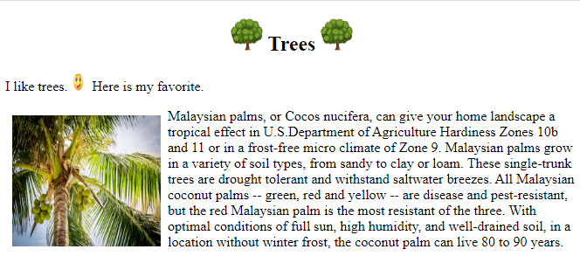
Outline
Shortcut Icon (continue…)
Example 1. (continue…)
Output:
For shortcut icons, the W3C recommends using a GIF or PNG file with dimensions of 16 × 16 pixels or 32 × 32 pixels. If you use an image file with dimensions different from 16 × 16 or 32 × 32, the browser will adjust its size, so it fits in the small square area reserved for the shortcut icon in the browser window’s tab.
But if the degradation occurs when an image file’s size gets adjusted, particularly if the original file’s size does not scale perfectly with the new file’s size.

Slide 8
Outline
iframe Element
In this section, we learn to display an image in a frame that’s embedded within the browser window. Specifically, we’ll use an iframe (short for inline frame) element to create a browsing context.
A browsing context is an area within a web page that can display an embedded web document, where a web document is something with a URL (i.e., a web page or a stored image).
Instead of loading an entire web page within an iframe’s browsing context, it’s more common to load a stored image into a browsing context.
The Art Exhibit web page’s website stores image files for that picture and three other pictures that all have the same dimensions. In addition, the website stores image files for the four smaller pictures at the left of example 2.
Those pictures are smaller versions of the larger pictures. When the user clicks one of the smaller images, the browser grabs the larger version of the clicked image and copies it to the browsing context area.
The smaller images are known as thumbnails. A thumbnail is a smallish image that serves as a representative for a larger version of that same image.
Thumbnails are often used to help with the organization of a group of images. In conjunction with that effort, they can help users to identify and select standard-size images.

Slide 9
Outline
iframe Element (continue…)
In the Art Exhibit web page’s source code in example 2A., In particular, note the iframe code, copied here for your convenience:
<iframe class="cell" name="full-size" width="480" height="320"
src="../images/kitchen3.jpg"></iframe>
The src attribute can specify a path to another web page, in which case the browser displays the entire specified web page in browsing context area.
When a user clicks one of the thumbnails, the image gets replaced by the image specified by the thumbnail.
In order to load a new image into the browsing context area, we need to be able to refer to iframe element, and name attribute’s value allows us to do that.
In the Art Exhibit web page, the a elements specify target="full-size" to connect to the iframe element. In the following code (from the Art Exhibit web page), note the target attribute and its full-size value:
<a href="../images/kitchen3.jpg" target="full-size">
<img src="../images/kitchenThumb3.jpg" alt="kitchen"></a>

Slide 10
Outline
iframe Element (continue…)
Example 2A.
<body>
<h1>Modular House Exhibit, Graphic Design Program</h1>
<h3>
Click a thumbnail at the left in order to move it to the viewing frame
at the right.
</h3>
<div class="table">
<nav class="cell">
<a href="../images/kitchen3.jpg" target="full-size">
<img src="../images/kitchenThumb3.jpg" alt="kitchen"></a>
<a href="../images/living.jpg" target="full-size">
<img src="../images/livingThumb.jpg" alt="living space"></a>
<a href="../images/stairway.jpg" target="full-size">
<img src="../images/stairwayThumb.jpg" alt="stairway"></a>
</nav>
<iframe class="cell" name="full-size" width="480" height="320" scrolling="no" src="../images/kitchen3.jpg"></iframe>
</div>
</body>
</html>

Slide 11
Outline
iframe Element (continue…)
In the past, we’ve only loaded another web page, but we can also load an image with the href attribute, and that’s what prior a element code indicates.
If there were no target attribute, the browser would implicitly use the value _self for the target attribute, which tells the browser to overlay the current web page with the href value. But with target="full-size", the target attribute tells the browser to open the man.jpg image in the full-size browsing context.
Formatting
There are a few formatting issues that are worth noting, to get the thumbnails to appear vertically at the left of the iframe’s browsing context area, we use a one-row two-cell table.
We use a nav container to hold all the thumbnails and form the left cell.
We use the iframe to form the right cell.
In the example 2A., the two-cell table is built with the CSS display property and table values. Also there is no element for the table’s row, which means we’re using an anonymous table-row element.
Peruse example 2B., see all CSS rules. Here’s the rule that implements table:
.table {
display: table;
display: flex;
align-items: flex-start;
}

Slide 12
Outline
iframe Element (continue…)
Formatting (continue…)
Example 2B.
<!DOCTYPE html>
<html lang="en">
<head>
<meta charset="utf-8">
<meta name="author" content="AAA">
<title>Modular House Exhibit</title>
<style>
body {
font-family: Garamond, serif;
background-color: lavender;
color: navy;
}
h1 { font-family: Papyrus, fantasy; font-size: 36px; }
.table {
display: table;
display: flex;
align-items: flex-start;}
.cell {display: table-cell;}
nav > * { display: block; margin: 18px 25px 18px 0; }
Align table cells at their tops.
Block formatting for the a elements.

Slide 13
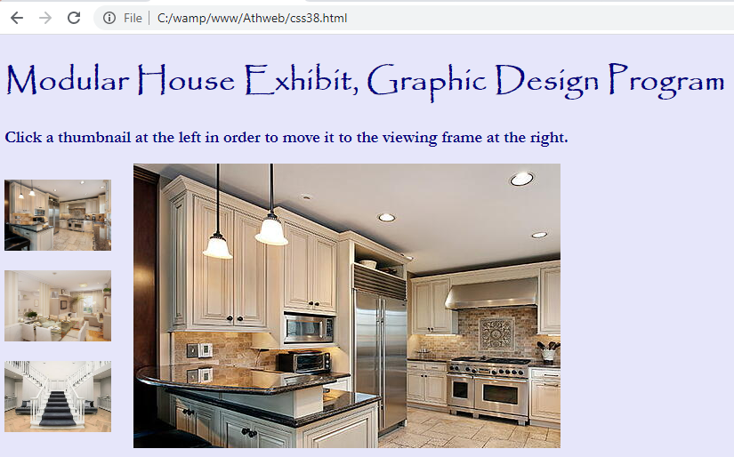
Outline
iframe Element (continue…)
Formatting (continue…)
Example 2B. (continue…)
a > img {
width: 120px;
height: 80px;
}
iframe {border: none; overflow: hidden;}
</style>
</head>
Output:
Promotes seamless integration of iframe’s browsing context with rest of web page..

Slide 14
Outline
iframe Element (continue…)
Formatting (continue…)
The display: table property-value pair converts a div container to a table, which is pretty straightforward. But the other two property-value pairs took quite a bit of head scratching to come up with.
To get the top thumbnail’s top to align with the large picture’s top, we introduced the flexible box layout (using display: flex) and the align-items: flex-start property-value pair.
The named flex-start value indicates top alignment.
Here’s the rule that causes the nav and iframe elements to become table cells, and it should look familiar:
.cell {display: table-cell;}
And here’s the rule that formats the individual a elements within the nav container:
nav > * {
display: block;
margin: 18px 25px 18px 0;
}
The rule matches all of the nav container’s child elements, which are a elements. By default, a elements use inline formatting. So without this rule, the browser displays the thumbnail links horizontally.

Slide 15
Outline
iframe Element (continue…)
Formatting (continue…)
To convert the a elements to block formatting, we use the display: block property-value pair. The margin: 15px 25px 15px 0 property-value pair prevents the pictures from touching each other. Next is the rule that specifies the thumbnail pictures’ dimensions:
a > img {
width: 120px;
height: 80px;
}
The width and height properties serve as an alternative to including width and height attribute-value pairs for each of the thumbnail img elements.
Browsers display a faint border around the iframe’s browsing context that distinguishes it from the rest the web page’s content.
Normally, we’re going to want to avoid that behavior. To get the browsing context to integrate seamlessly with the rest of the Art Exhibit web page, we use the following CSS rule:
iframe {border: none; overflow: hidden;}
The border-none property-value pair makes the iframe’s browsing context border invisible.
If the iframe’s content is larger than the iframe’s dimensions, the browser displays scrollbars so all of the content can be accessed. The overflow-hidden property-value pair clips content so no scrollbars display.

Slide 16
Outline
CSS Image Sprites
In this section, we once again use the a element for something other than its standard purpose. We use it to implement a rollover. A rollover is when an image file changes due to the user moving the mouse over the image. Rollovers have been around for quite a long time.
We used in previous a:hover to change the link’s color and the link’s underlining when the user’s mouse hovers over the link.
To implement a rollover, we’ll once again use the a:hover pseudo-class selector, but this time we’ll get fancier than just changing the link’s color and underlining.
We’ll use CSS to overlay an image with a new image. You might think that the two images come from two different image files. Au contraire! It’s quicker to download one file rather than two, so we stuff both images into one file and use CSS to view only one of the images at a time.
The browser animates the images so the user views only one image at a time. You might have heard the term “sprite” from game programming, where a sprite is a bitmap file that gets integrated into a larger scene to help with animations.
Example 3., we can see the scratchSprite.png image file that contains three images of Scratch1 the cat. When the web page first loads, the browser displays the first image, which you can see in the screenshot at the left. If the user hovers the mouse over Scratch, the browser displays the second image.

Slide 17
Outline
CSS Image Sprites (continue…)
If the user clicks Scratch, the browser displays the third image. For a rollover, all we need are two images, not three. We add a third image here to show how we can capture and process a mouse click.
In the Scratch web page source code in example 3., note the a element code, copied here for our convenience:
<a id="scratch"></a>
All the work is done by the CSS rules. Here’s the first CSS rule, which determines what happens when the web page first loads:
#scratch {
display: block;
width: 300px;
height: 170px;
background-image: url(../images/scratchSprite.png);
background-position: 0 0;
}
#scratch is an ID selector that matches elements that have id="scratch". The web page’s a element has id="scratch", so this rule applies to that a element.
We noticed that the Scratch web page a element consists of two tags and no content between them. That means, by default, the link would display nothing.
The image file comes from the background-image property.

Slide 18
Outline
CSS Image Sprites (continue…)
The CSS rule’s display: block property-value pair, together with the width and height properties and their values, tell the browser to display the background image within a 300 × 170 rectangular area. The 300 × 170 dimensions match the dimensions of each of the three images in the image file.
The “background image’s element” is the a element link, which the CSS rule formats as a 300 × 170 block. So the background position values of 0 and 0 indicate that the image file content’s top-left corner gets positioned at the top-left corner of the link’s block.
The browser displays only the first image and crops off the bottom two images. Cropping means to cut something off so browser doesn’t display it. The next two CSS rules take care of displaying the bottom two images:
#scratch: hover {background-position: 0 -244px;}
#scratch: active {background-position: 0 -488px;}
The #scratch: hover pseudo-class rule indicates that when the mouse hovers over the link’s block, the image file content’s top-left corner gets positioned 244 pixels above the top-left corner of the link’s block.
With each image being 170 pixels tall and with a 2-pixel gap between images, that means the browser displays the middle image and crops off the top and bottom images.
The second rule uses the :active pseudo-class selector. When used with an a element, that selector matches any link that is currently active. A link is “currently active” when user holds the mouse button down on the link.

Slide 19
Outline
CSS Image Sprites (continue…)
Example 3.
<!DOCTYPE html>
<html lang="en">
<head>
<meta charset="utf-8">
<meta name="author" content="AAA">
<title>Scratch</title>
<style>
body {background-color: #f1daf1;}
#scratch {
display: block;
width: 300px;
height: 170px;
background-image: url(../images/scratchSprite.png);
background-position: 0 0;
}
#scratch:hover {background-position: 0 -244px;}
#scratch:active {background-position: 0 -488px;}
</style>
</head>
<body>
<h1>Scratch - Imagine, Program, Share</h1>

Slide 20
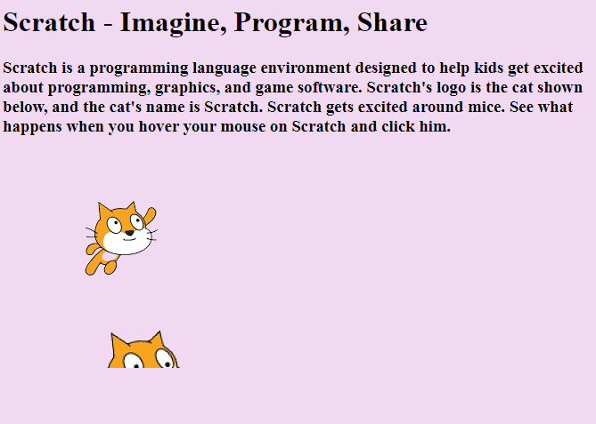
Outline
CSS Image Sprites (continue…)
Example 3.
<h3>
Scratch is a programming language environment designed to help
kids get excited about programming, graphics, and game software.
Scratch's logo is the cat shown below, and the cat's name is
Scratch. Scratch gets excited around mice. See what happens
when you hover your mouse on Scratch and click him.
</h3>
<a id="scratch"></a>
</body>
</html>
Output:

Slide 21
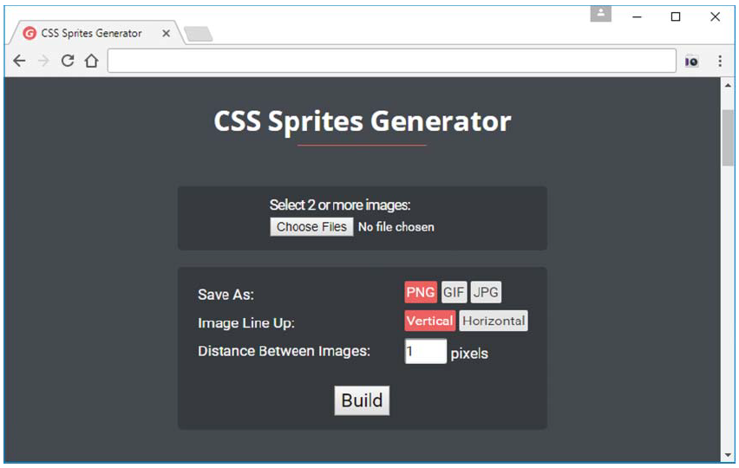
Outline
CSS Image Sprites (continue…)
Making a CSS Image Sprite File
To make a sprite image file, you can draw the file’s images directly using a graphics application like Adobe Photoshop or GIMP (GNU Image Manipulation Program). As an alternative, you can find separate images, resize them so they have the same dimensions, and then use a tool to merge the images into one file.
For the scratchSprite.png file shown in example3., we found the Scratch images on the Google Images website and copied each image to its own file. We used GIMP to (1) resize each file to 300 × 170 pixels and (2) add transparency to each image’s background.
The transparency isn’t required, but in example 3., screen capture, you should be able to appreciate the simple elegance of Scratch’s transparent background being overlaid with pink from the body element’s background color property.
After creating the three image files, we used a tool to merge the images into one file. Specifically, we used the CSS Sprites Generator tool found at https://www.giftofspeed.com/sprite -generator/, as shown in figure 2.
Figure 2. CSS Sprites Generator

Slide 22
Outline
Audio
Audio
In this section, you’ll learn how to implement an audio player with the audio element. Prior to HTML5, end users had to install a plug-in to play sound from a web page. Now there’s no need for that. Today’s browsers include a built-in audio player that’s used in conjunction with the audio element. Here’s a simple audio element example:
<audio src="../audio/A3.mp3" preload="auto" controls>
</audio>
audio Element Attributes
In the prior audio element code fragment, note the src attribute. It specifies a path to an audio file named A3.mp3. As you’d expect, the filename’s .mp3 extension indicates that the file is an mp3 file.
The controls attribute tells the browser to display an audio control bar (for starting, pausing, and adjusting the volume) for the audio player. You should always include the controls attribute. If you don’t, some users will be annoyed that they are unable to stop the sound. In the code fragment, note how the controls attribute isn’t assigned a value.
When you specify an attribute by itself, that’s known as an empty attribute. As an alternative, it’s legal to specify a dummy value or empty string like this:
controls="controls"
controls=""

Slide 23
Outline
Audio (continue…)
audio Element Attributes (continue…)
The preload attribute indicates whether the browser should download audio information when the web page first loads, or wait to download if and when the user starts the audio player.
If there’s a preload value of( auto or the empty) string (""), the browser takes that as a suggestion to download the audio file when the page loads initially.
If there’s a preload value of (meta ), the browser takes that as a suggestion to download the metadata (e.g., duration) when the page loads initially.
If there’s a preload value of (none), the browser downloads no audio information when the page loads initially.
The audio element’s (auto play )attribute tells the browser to start playing the audio file when the page first downloads. If we provide an auto play attribute, there’s no need to specify preload because preloading occurs regardless of the preload attribute’s value.
Autoplay is used for sounds that are meant to be played in the background. if you do use autoplay, you should make sure to include the controls attribute, so the user can turn off the sound if necessary.
Audio File Formats
Different browsers support different audio file formats. To handle that situation, we can omit the audio element’s src attribute and, instead, include source elements between the audio element’s start and end tags.

Slide 24
Outline
Audio (continue…)
Audio File Formats (continue…)
An example that uses multiple source elements to make it extremely likely that the browser supports at least one of the rainstorm audio file formats:
<audio autoplay controls loop>
<source src="../audio/rainStorm.mp3" type="audio/mpeg">
<source src="../audio/rainStorm.wav" type="audio/wav">
<source src="../audio/rainStorm.ogg" type="audio/ogg">
</audio>
For maximum browser compatibility, you should include source elements for these three popular audio file formats—.mp3, .wav, .ogg. Chrome and Firefox support all three audio formats, but Internet Explorer supports only the mp3 format. Older browsers have less support, so for the next several years, you should provide multiple source elements with multiple file formats.
The browser loads the first file that uses a format that the browser supports, so in processing the code fragment, if a browser supports all three file formats, the browser will use the mp3 file.
Halloween Sounds Web Page
In example 4., note the rainstorm sound’s audio player, and note the two other players for the witch’s cackle sound and the werewolf sound. The rainstorm sound’s audio element includes autoplay and loop attributes. That tells the browser to start playing the rainstorm sound when the page first downloads and to replay the sound in a loop.

Slide 25
Outline
Audio (continue…)
Halloween Sounds Web Page
As an indication that the rainstorm sound is currently playing, you can see that the rainstorm audio player displays a pause button. The other players are not currently playing, so you can see that they display play buttons.
It’s reasonable to assume that the user will want to play all three Halloween sounds. The bottom two audio elements include preload attributes in order to speed things up. We want the rainstorm audio file to be preloaded as well, but there’s no preload attribute in its audio element. Why? Because its autoplay attribute tells the browser to preload the audio file regardless of the presence of a preload attribute.
Background Images
You can see the entire Halloween Sounds web page source code in example4., but we’ve copied the background-image property CSS rule here for your convenience:
body {background-image: url(../images/pumpkin.jpg);}
The background-image property uses a URL value to specify the background image’s file. Note the URL value’s syntax—url and then parentheses around a path and a filename. As an option, you can surround the path and filename with single quotes or double quotes.

Slide 26
Outline
Background Images (continue…)
Background Images (continue…)
Using an Image to Cover a Web Page’s Background
If you use a background image for a web page, you can’t count on the image’s dimensions matching the browser window’s dimensions. Actually, it’s the viewport’s dimensions that matter.
Suppose that a web page’s background image is smaller than the browser window’s viewport. That can lead to boring dead space surrounding the background image.
There are several strategies for overcoming that potential problem.
The first strategy is to rely on the default behavior where the browser fills the entire viewport by displaying multiple copies of the image using a tiled layout, as shown in example 4., the photos In the output called “tiling” because it’s similar in appearance to tiles on a kitchen floor.
Second strategy for overcoming the dead space problem is to use an image large enough to cover most monitors. If you choose a picture that’s 1600 pixels wide and 1200 pixels tall, the result should look pretty good because the picture will cover most users’ windows. A drawback of using a large fixed image is that the background image will often be cropped significantly.
A third strategy for overcoming the dead space problem is to have the browser automatically expand the background image to conform to the size of the viewport while maintaining the background image’s original shape.

Slide 27
Outline
Background Images (continue…)
Background Images (continue…)
Example 4.,
<!DOCTYPE html>
<html lang="en">
<head>
<meta charset="utf-8">
<meta name="author" content="AAA">
<title>Halloween Sounds</title>
<style>
@font-face {
font-family: Buffied;
src: url(../fonts/buffied.woff) format("woff"),
url(../fonts/buffied.ttf) format("opentype");
}
h1, h3 {color: white; font-family: Buffied, serif;}
h1 {font-size: 5em;}
h3 {font-size: 3em; margin-bottom: 0;}
body {background-image: url(../images/pumpkin.jpg);}
</style>
</head>
<body>
<h1>Halloween Sounds</h1>
<h3>Rainstorm:</h3>

Slide 28
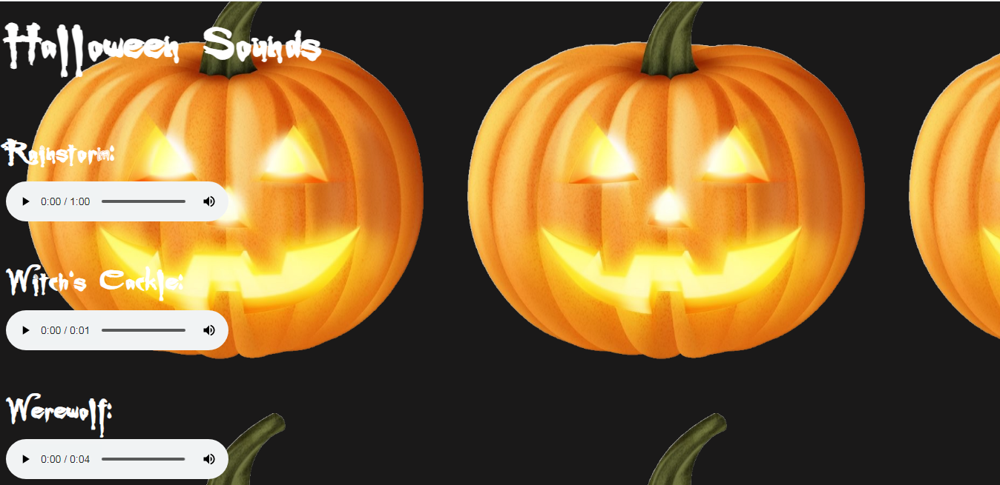
Outline
Background Images (continue…)
Background Images (continue…)
Example 4., (continue…)
<audio autoplay controls loop>
<source src="../audio/rainStorm.mp3" type="audio/mpeg">
<source src="../audio/rainStorm.wav" type="audio/wav">
<source src="../audio/rainStorm.ogg" type="audio/ogg">
</audio>
<h3>Witch's Cackle:</h3>
<audio src="../audio/witchesCackle.mp3" preload="auto" controls></audio>
<h3>Werewolf:</h3>
<audio src="../audio/werewolf.mp3" preload="auto" controls></audio>
</body>
</html>
Output:
Better to have multiple file formats
(with source elements) than just one
file format (with the src attribute).

Slide 29
Outline
Background Images (continue…)
Background Images (continue…)
The improved Halloween Sounds web page uses the background image is scaled, same code as before, except for its body CSS rule. Here’s that rule:
body {
background-image: url(../images/pumpkin.jpg);
background-size: cover;
background-attachment: fixed;
background-position: center;
}
Note the background-size: cover property-value pair. It tells the browser to initiate the scaling process for the background image. Specifically, the browser attempts to “cover” the web page’s background by scaling the image such that its larger dimension matches the width or height of the viewport.
As for the smaller dimension, unless the image’s dimensions and the viewport’s dimensions scale perfectly, the smaller dimension won’t match the viewport.
If the user resizes the browser window to make its small dimension even smaller, that can lead to a cropped image.
We can see that situation at the left side of Figure 3., where the background image’s vertical dimension is smaller than the viewport.
Note the background-attachment: fixed property-value pair. Its primary purpose is to “fix” the background so if there’s a scrollbar and the user scrolls the background remains stationary.

Slide 30
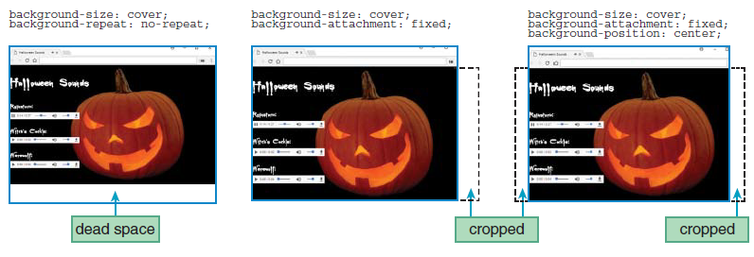
Outline
Background Images (continue…)
Background Images (continue…)
A secondary purpose is to help with covering the viewport if it’s used in conjunction with the background-size: cover property value pair.
Specifically, if both property-value pairs are used (as is the case for the improved Halloween Sounds web page), and if the viewport is larger than the background image’s native size, the browser expands the background image so there is no uncovered space in either dimension.
The end result is that one of the background image’s dimensions will match the viewport and the other dimension will be greater than the viewport. Unfortunately, that will cause the image to get cropped along the dimension that’s larger than viewport.
Figure 3., Effect of different background properties on Halloween Sounds web page

Slide 31
Outline
Background Images (continue…)
Background Images (continue…)
Another background property that you should be aware of is the background-position property. In the improved Halloween Sounds web page, we use a value of center for that property, which tells the browser to center the background image horizontally.
If you omit the background-position property, the browser positions the background image with its top left corner in the top-left corner of the browser window’s viewport.
In the improved Halloween Sounds web page, we use the background-position property to specify the image’s horizontal position. As for the vertical position, the default is to position image with center alignment, and that works fine most of time.
Here’s an example that positions a background image with its right edge at the viewport’s right edge and its bottom edge at the viewport’s bottom edge:
body {
background-image: url(../images/pumpkin.jpg);
background-size: cover;
background-attachment: fixed;
background-position: right bottom;
}
For the background-position property’s first value, you can specify pixels from the left edge or you can specify left, center, or right.

Slide 32
Outline
Web Fonts
In this section, we explore how you can incorporate such nonstandard fonts, called web fonts, into our web pages.
For standard fonts (such as Tahoma and Courier New), you can be reasonably confident that those fonts will be installed on users’ computers and they will work. But to be safe, you should always include a generic font family in each of your CSS font-family rules.
On the other hand, nonstandard fonts will not normally be preinstalled on users’ computers, so to get them to work, you’ll need to use a CSS @font-face rule.
They’re called at-rules because they use the @ symbol. Here’s the at-rule used in the Halloween Sounds web page:
@font-face {
font-family: Buffied;
src: url(../fonts/buffied.woff2) format("woff2"),
url(../fonts/buffied.woff) format("woff");
}
Note the at-rule’s first line: @font-face. All at-rules begin that way, with “@” and then an identifier that specifies the type of at rule that’s being defined. Note also the font-family property and its value of Buffied.
The font-family property’s value provides the name with which later code can refer to the new font. note how the h1 and h3 elements are able to use the Buffied font:
h1, h3 {color: white; font-family: Buffied, serif;}
Now let’s examine the src attribute in the Buffied at-rule. In particular, note the two web font files with .woff and .woff2 extensions.
newly created font

Slide 33
Outline
Web Fonts (continue…)
Those two files use the WOFF (Web Open Font Format) and WOFF 2.0 web font formats, introduced in 2010 and 2016, respectively. The WOFF 2.0 web font format does a better job with compression, with WOFF 2.0 files showing a 30% reduction in file size when compared to WOFF files.
Current browsers support WOFF 2.0 files, but to accommodate older browsers, you should probably include both WOFF and WOFF 2.0 files in your at-rules, as is the case with the Halloween Sounds at-rule.
When searching for web fonts on the Internet, you’ll probably have a hard time finding WOFF and WOFF 2.0 files. But it’s easy to find files with the extension .ttf, where ttf stands for (TrueType font). We can use a TrueType font file on our web page, we can do so by adding it to an at-rule’s src attribute like this:
url(../fonts/Buffied.ttf) format("truetype");
Video
We’ll learn in this section, how to implement a video player with the video element. The video element is fairly similar to the audio element, so much of this discussion should sound familiar.
video Element Syntax
Today’s browsers include a built-in video player that’s used in conjunction with HTML5’s video element. Here’s a video element example:
<video src="stBernardClimbsFlagPole.mp4"
width="350" height="260"
preload="metadata" controls
poster="stBernardClimbsFlagPole.jpg">
</video>

Slide 34
Outline
Video (continue…)
The video element requires a start tag and an end tag even when there’s no content between the tags. In this example, there’s no content between the tags.
Let’s run through the attributes for the video element. As is customary, the src attribute specifies a path to a file. In this example, the src attribute’s file is an .mp4 video file.
The width and height attributes specify the size of the video’s display box in pixels.
Without the width and height attributes, the browser has to wait for the video file to download to know the video’s dimensions, which affect the position of the surrounding content.
If you specify larger dimensions for the video box than the video object’s natural dimensions, the browser will display the video with the specified dimensions.
If you use dimensions that are not properly scaled, the browser will display the video, but we'll have blank areas along the edges to fill in the video box to the specified dimensions.
If you specify preload="metadata", that asks the browser to download information about the video file (dimensions, duration, etc.), the first frame, and possibly a few additional frames.
To decrease the delay when the user clicks the play button, you can specify preload="auto", which asks the browser to preload the entire video, not just the video’s metadata information.
We can specify preload="none", which asks the browser to download no video information when the page initially loads.
The poster attribute specifies an image that displays while the video is not playing, thus overriding the default behavior of using the video’s first frame for the paused video display.

Slide 35
Outline
Video (continue…)
The controls attribute causes a control bar to display. The control bar allows the user to start and pause the video and adjust the volume. You should always include the controls attribute with the video element because without it, users will probably get annoyed at not being able to control the video.
Different browsers support different video file formats. To handle that situation, you can omit the video element’s src attribute and, instead, include multiple source elements between the video element’s start and end tags. For example:
<video width="397" height="225" preload="metadata" controls
poster="../images/groceryStore.jpg">
<source src="../video/videoplayback.mp4" type="video/mp4">
<source src="../video/videoplayback.webm" type="video/webm">
</video>
The W3C recommends that you use those types of files (.mp4 and .webm) because they’re popular and well supported by today’s browsers. Formally, those file types use the MPEG-4 format and the WebM format.
We should include a type attribute with each source element. For example, in the prior video element, the first source element uses type="video/mp4".
TV Advertisements Web Page
In example The TV Advertisements web page’s code there are two parts the 5A., and 5B., The body container implements two videos. The first video is implemented with a video container and uses the code described earlier. The second video is implemented with an iframe container, and it deserves an explanation.

Slide 36
Outline
Video (continue…)
As an alternative to playing a video directly from a web page with a video element, you can use an iframe element to play a video on an external web page. Here’s an example, copied from the TV Advertisements web page:
<iframe width="400" height="225" allowfullscreen
src="https://www.youtube.com/embed/CCNbdx-CmHE?start=120"> </iframe>
Note the allowfullscreen attribute, which enables users to expand the video to full-screen mode.
There are pluses and minuses to using iframe element to play a video on an external web page versus using video element. First, the advantages of using iframe element: You don’t have to create your own video files or find video files you can copy.
On the other hand, there are advantages of using the video element: Users are not required to install a video player plug-in. Also, you’re not dependent on an external web server continuing to host the video.
Finally, you can use JavaScript to customize your video, and you can avoid an external web page’s customizations (like advertisements).

Slide 37
Centering Content Within the Viewport, Color Gradients
Outline
Web Page’s Layout
Note that the two video boxes and their headings are side-by-side. We achieved that look by using CSS. Specifically, we defined a table with the display: table property-value pair and two table cells with display: table-cell property-value pairs.
The TV Advertisements head container in example 5B, and find those property-value pairs. Also, find their associated class="table", class="cell" attribute-value pairs in example 5A’s body container.
We used text-align: center to center the heading’s tree icons and text horizontally within the heading. But for the TV Advertisements web page, we want to center the web page’s entire contents within the browser window’s viewport.
And the entire contents consist of more than just block containers with inline objects inside them. Specifically, we want to center the contents of the table we created for the adjacent video objects.
As you can verify by examining the source code, the table is a div block element and each video object is part of its own div block element. So the text-align property won’t help to center the table of two video objects.
To center the contents of a block element when the block contains other block elements, we first need to convert the outer block element to a flexbox, which generates a flexible box layout for the outer block element.
To create a flexbox, we apply a display: flex property-value pair to outer block element.
The easiest way to do that is to center the body element within its container. So, what contains the body element?

Slide 38
Centering Content Within the Viewport, Color Gradients (continue…)
Outline
Web Page’s Layout (continue…)
The html element. So the solution is to use display: flex to turn the html element into a flexbox, and then we add the magic centering property-value pairs to the html element.
We add justify-content: center to the html type selector rule to center the html element’s contents horizontally. And we add align-items: center to the html type selector rule to center the html element’s contents vertically. That centers the body element within the viewport.
The html type selector rule in 5B, and we’ll see the three property-value pairs just mentioned, plus a fourth property-value pair, height: 100vh. As you might guess, the height property assigns a height to an element. Normally, the height of the html element is the height of the web page’s content
.
Using a Color Gradient to Cover a Web Page’s Background
In the TV Advertisements web page in example 5., for the background, we can see a color gradient that transitions from blue to blue-green to orange. Here’s the code that implements that color gradient:
body { background-image: linear-gradient(to right, blue, #00ffff, #ff7700); }
In the Halloween Sounds web page, we used background-image with a url value (for specifying an image file), and here we’re using it with a linear-gradient value (for specifying a color gradient). You can use a linear-gradient value anywhere you can use an image file value

Slide 39
Centering Content Within the Viewport, Color Gradients (continue…)
Outline
. The linear-gradient’s last three arguments specify the gradient’s colors. The colors are blue, green-blue, and reddish orange. The linear-gradient’s first argument, to right, specifies the direction that the gradient’s colors flow. The word after “to” specifies target, where you can use right, left, bottom, or top for the target value.
Example 5-5B.,
<!DOCTYPE html>
<html lang="en">
<head>
<meta charset="utf-8">
<meta name="author" content="AAA">
<title>TV Ads</title>
<style>
html {
height: 100vh;
display: flex;
justify-content: center;
align-items: center;
}
body {
background-image: linear-gradient(to right, blue, #00ffff, #ff7700);
background-attachment: fixed;
text-align: center;
}
The html type selector rule
centers the body element
within the viewport.
This creates a color gradient.

Slide 40
Centering Content Within the Viewport, Color Gradients (continue…)
Outline
Using a Color Gradient to Cover a Web Page’s Background
Example 5-5B., (continue…)
.table {
display: table;
border-spacing: 20px; }
.caption {
display: table-caption;
font-size: xx-large;
}
.cell {display: table-cell;}
</style>
</head>
Example 5-5A
<body>
<div class="table">
<div class="caption">Television Advertisements</div>
<div class="cell">
<h3>Kid in a Grocery Store:</h3>
<video width="397" height="225" preload="metadata" controls
poster="../images/groceryStore.jpg">
<source src="../video/videoplayback.mp4" type="video/mp4">
<source src="../video/videoplayback.webm" type="video/webm">
</video>
This creates a table layout.

Slide 41
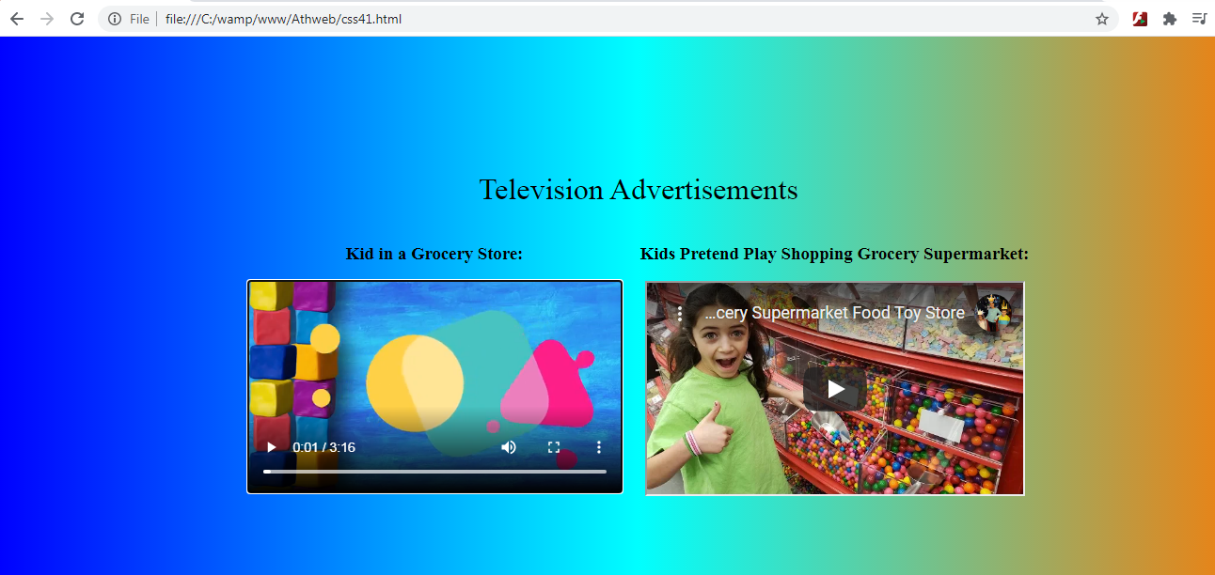
Centering Content Within the Viewport, Color Gradients (continue…)
Outline
Using a Color Gradient to Cover a Web Page’s Background
Example 5A., (continue..)
</div>
<div class="cell">
<h3>Kids Pretend Play Shopping Grocery Supermarket:</h3>
<iframe width="400" height="225" allowfullscreen
src="https://www.youtube.com/embed/CCNbdx-CmHE?start=120"></iframe>
</div>
</div>
</body>
</html>
Output:

Slide 42
Outline
Summary
In this lecture we explained the positioning Images that mean specifies the type of positioning method used for an element.
We clarified the meaning of shortcut icon In Windows, it was an icon that points to a program or data file. Shortcuts can be placed on the desktop or stored in other folders, and clicking a shortcut was the same as clicking the original file.
Also we explained the iframe meaning which was used to display an image in a frame that’s embedded within the browser window. Specifically, used an iframe element to created a browsing context.
This lecture highlighted also the meaning of CSS Sprites that were a means of combining multiple images into a single image file for use on a website, to help with performance.
The audio element was used to play an audio file on a web page, and it had more than attribute like the controls attribute adds audio controls, like play, pause, and volume. The source element allowed to specify alternative audio files which the browser may choose from.
We used the background-image property to specify a URL to an image file and also we clarified how can Used an Image to Cover a Web Page’s Background.
In this lecture, we explained briefly the web font meaning and we explored how we could incorporate non standard fonts, called web fonts, into our web pages.
This lecture highlighted the description of the video element that used to show a video on a web page and it had more than attribute like the controls attribute adds video controls, like play, pause, and volume and also always include width and height attributes. The source element allowed us to specify alternative video files which the browser may choose from.
finally we discussed briefly the meaning of centering content within the viewport, color gradients that included how to center the web page’s content within viewport.

Slide 43


THANK YOU

